Slide 1


BTS-Books to Search
Neurons
Farnaz Arghavan
Divyangana Kothari
Manoj Kumar Dara
Julian Stülp

Slide 2





Overview
What is BTS?
Implementation
Conceptual Solution
Result
Summary

Slide 3
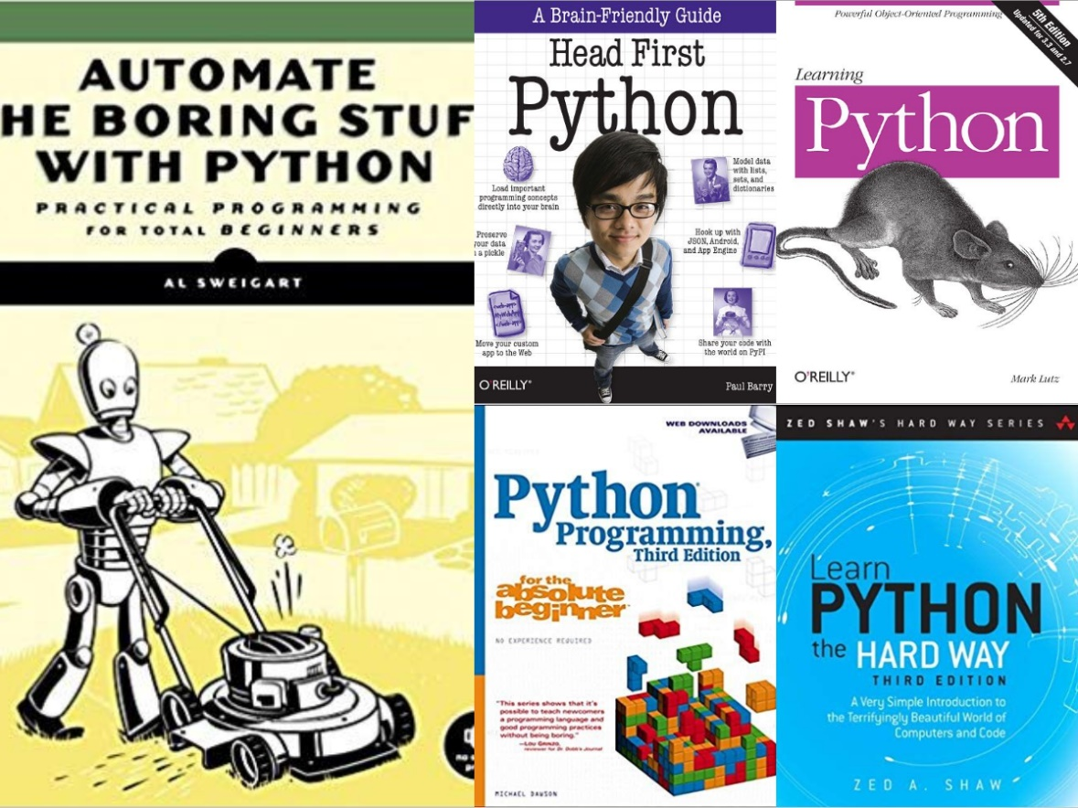

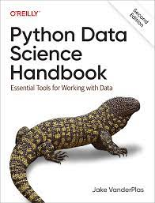
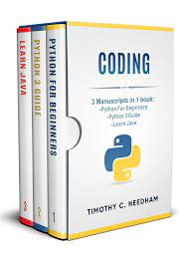

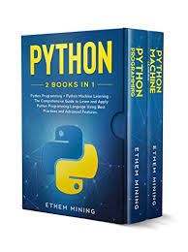
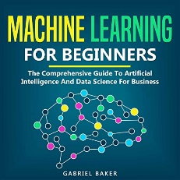
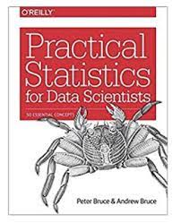
What is BTS?
Despite the availability of instructional videos, books continue to be a crucial tool for learning new technology and obtaining knowledge. They've been with us for a long time and continue to play a vital role in our educational path.
Abstract
A book recommendation system based on embedding, with interactive representations of recommended books.

Slide 4

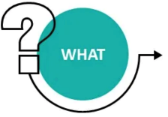
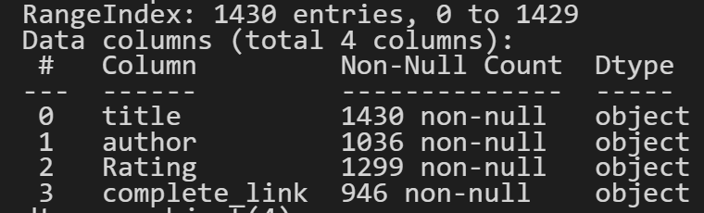



What –Why – How
The data used for this project includes book titles, which will be used to generate embeddings for each book.
Data Information
The data is cleaned and preprocessed before being used to train the model to make sure it is accurate and useful.
MySQL DB is used to store and retrieve datasets.

Slide 5
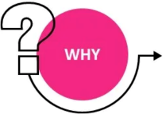
What –Why – How
To provide a personalized book recommendation system that takes into account the user's search query and suggests books that are semantically related to the query.
Action – Target pairs
Discover features of books by using embeddings
Locate relevant books based on user's query
Compare similarities between books,
Summarize trends in the recommended books data
Derive insights from the data for the recommendation system.

Slide 6
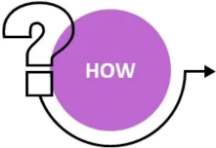
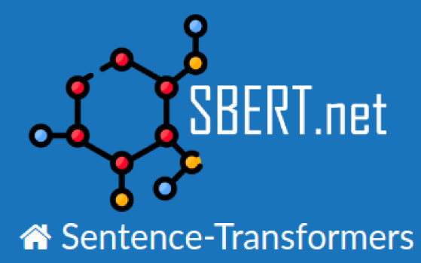
What –Why – How
The book titles are used to generate embeddings for each book using Sentence Transformer.
The embeddings are used to calculate the similarity between books using Semantic Search.

Slide 7

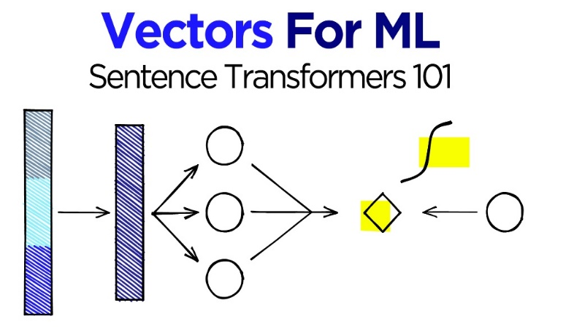
What –Why – How
Sentence Transformer is a library that allows for the generation of sentence embeddings for natural language processing tasks.
BERT (Bidirectional Encoder Representations from Transformers) is based neural network model that is used to generate sentence embeddings.
It can be fine-tuned for various natural language processing tasks such as text classification, question answering, and more.
Source :Sentence-Embeddings

Slide 8
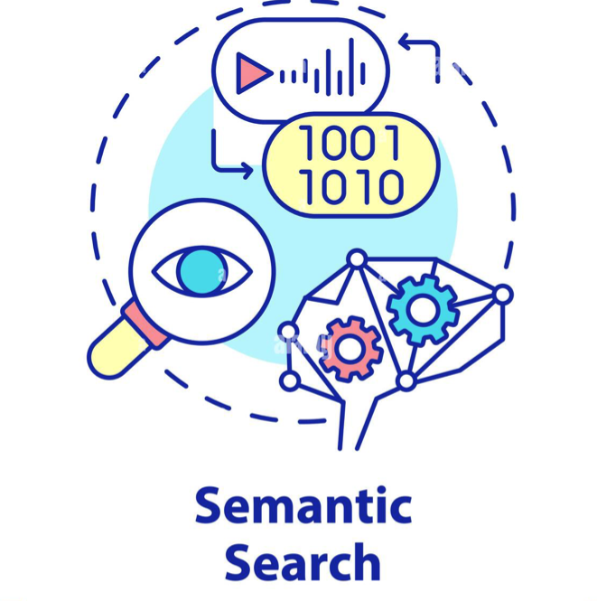
What –Why – How
Semantic search uses natural language processing techniques such as word embeddings to understand the intent behind a user's query and return semantically related results.
It takes into account context and synonyms to provide more accurate results.
The Sentence Transformer library uses cosine similarity as the default similarity measure when generating embeddings.

Slide 9




Design Choice
What (Data): | Book titles(Categorical – Nominal), ratings(Quantitative – Ordinal)
Why (Tasks): | Discover features, Locate, Compare similarities, Summarize trends , Derive
How (Encode): | Embeddings using Sentence Transformer and BERT model.
How (Facet): | Grouping the recommended books by ratings
How (Reduce) | Using Semantic search
How (Manipulation) | Similarity scores to compare

Slide 10
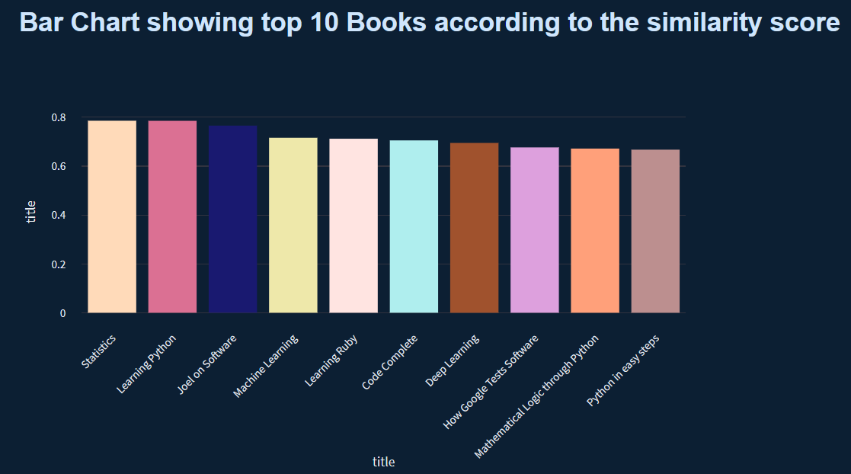
Data Visualization _Bar chart
What
X-axis ‘Titles’ (One categorical)
Y-axis ‘Similarity Score’ (One quantitative)
How
Channels :
Position channel: The x-axis and y-axis will be used to position the bars.
Length channel: The length of the bars will represent the similarity scores.
Color channel: Different colors can be used to distinguish between different books
Marks :
Bar marks: The bars themselves will represent the data.
Text marks: Labels will be used to identify the book titles on the x-axis.

Slide 11
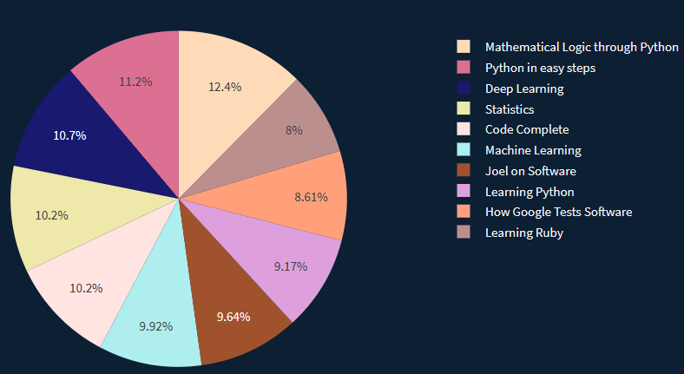
Data Visualization _Pie chart
What (One categorical)
Represent proportions of different ‘Titles’
How
Channels :
Size : The size of each wedge representing the rating of that title.
Color channel: Different colors can be used to distinguish between different books
Marks :
The different sections of the pie chart representing each title

Slide 12
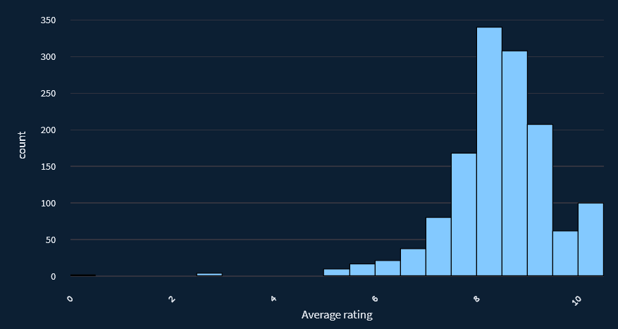
Data Visualization _ Histogram
What (2 Quantitative)
Distribution of a dataset.
How
Channels :
X-axis represents the range of ratings in the dataset, Y-axis represents the frequency of those values.
Marks :
The bars of the histogram representing the frequency of a certain range of values in the dataset

Slide 13








Implementation
Data Collection from Kaggle
Pre-processing of data, including cleaning and tokenization
Encoding of data using Sentence Transformer and BERT model
Ranking of book titles based on similarity scores
Visualization of top 10 book titles
Output:
Recommended book titles for the search query, with visual representation of similarity scores and book ratings.

Slide 14




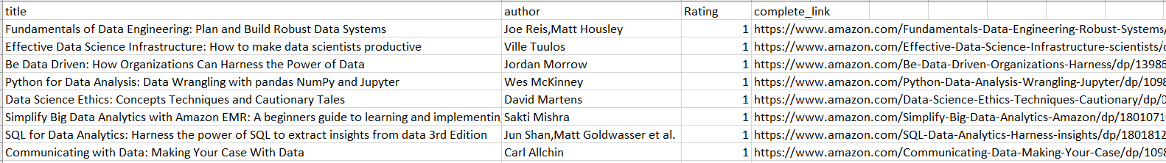
Conceptual Solution
Dataset 1
Dataset 2
Dataset 3

Slide 15

Conceptual Solution
Bert Transformer
Tokenization
Word Piece tokenizer to break down words into smaller pieces
Input Representation
Converted into numerical representations called "input IDs.
Pre-training
Contextual relationships between words and predicts the missing tokens
Encoding
Self-attention mechanisms to generate word embeddings
Output Representation
Final word embedding
Input
Search Query
Source - The Illustrated Transformer

Slide 16







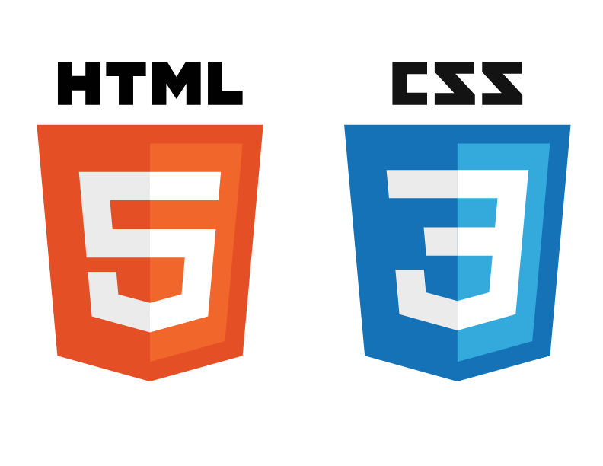
Conceptual Solution
Technologies used:

Slide 17

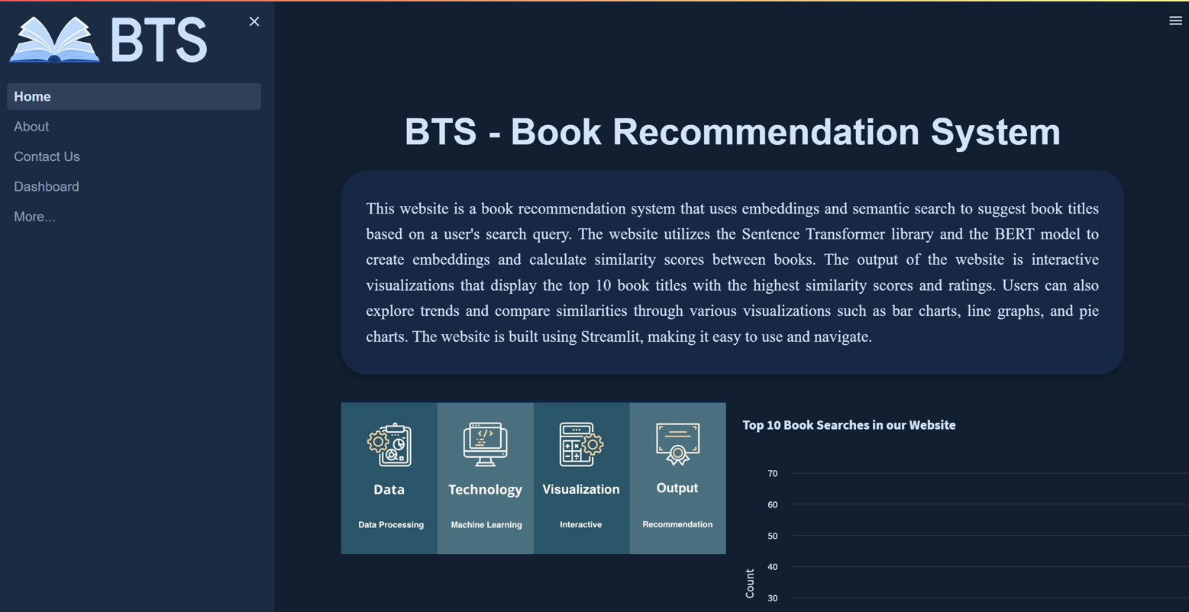

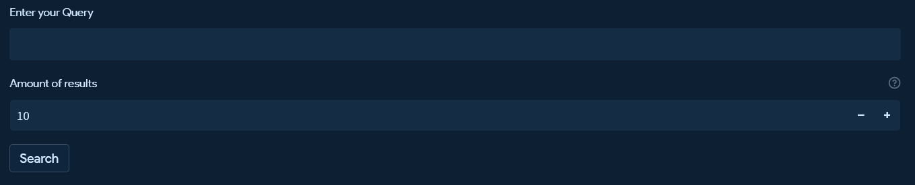

Results
Homepage

Slide 18
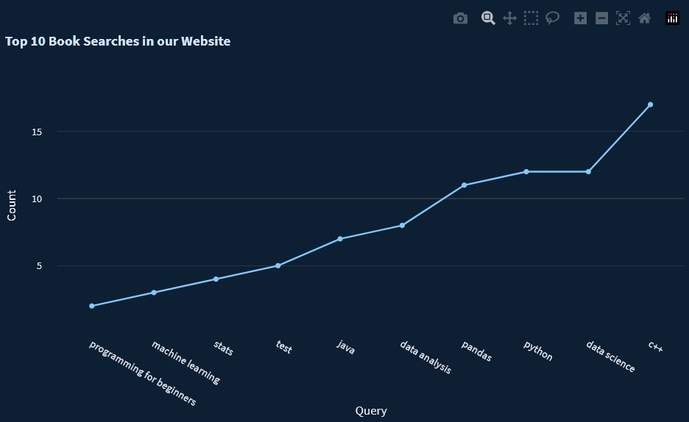
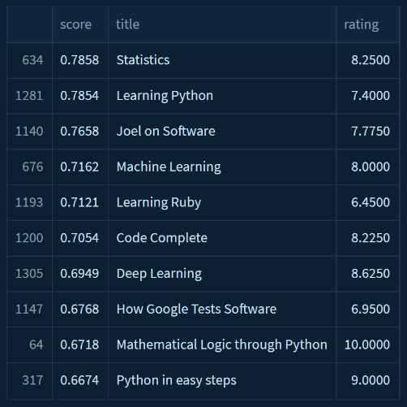
Results
Line graph for top queries
Table for top 10 books with scores

Slide 19


Results

Slide 20


Results
Demo – 10 minute

Slide 21




Summary
Data – List of books with titles, ratings…
Providing a user-friendly book recommendation system,
and engaging way for users
Embeddings, Interactive Visualization, Web application
Students , Who are looking for recommendations on books

Slide 22

Summary
Future Improvements
Improving the recommendation additional features such as book genres, description, and user preferences.
Expanding the database of books to include a larger variety of titles.
Improving the interface to make it more user-friendly.

Slide 23
Task Allocation
Data Collection & Database
Manoj
Julian
Data Cleaning & Machine Learning model
Web frame work
Manoj
Visualization
Manoj
Divyangana
Frontend
Divyangana
Julian
Farnaz

Slide 24
Schedule
Week 1 | Week 2 | Week 3 | Week 4 | Week 5 | Week 6 | Week 7 | Week 8
Project Idea
Data collection & approach
Database &
ML model
Web framework &
Visualizations
Frontend development
Miscellaneous

Slide 25









References
 | GitHub | https://github.com/Manojkdara/Books-to-Search-BTS-
 | ChatGPT | https://chat.openai.com/chat
 | Pretrained models | https://huggingface.co/models
 | Streamlit | https://docs.streamlit.io/
 | MySQL | https://www.w3schools.com/mysql/default.asp
 | Plotly | https://www.geeksforgeeks.org/python-plotly-tutorial/
 | Dashboard | https://startbootstrap.com/theme/sb-admin-2
 | Streamlit Tutorials | https://www.youtube.com/playlist?list=PLuU3eVwK0I9PT48ZBYAHdKPFazhXg76h5
 | Lecture Slides | Lecture notes of Prof. Dr. Mohamed Amine Chatti on Learning Analytics

Slide 26


